Slide 1
Some culturally responsive pedagogies for mathematics teaching
Peter Sullivan

Slide 2
Abstract
The curriculum for Australian students is intended to be inclusive of all students whatever their cultural background. This does not mean that all students should be taught the same way.
An important challenge for teachers is to explore pedagogies with which all students are comfortable, and especially those which acknowledge preferred learning and communication styles and cultural expectations of Indigenous students.
The webinar will outline some of these pedagogies especially:
  Communicating high expectations through the use of age appropriate experiences that are appropriately challenging and which build connections between mathematical ideas
  Recognising the relationship between language and learning, and the load that instruction using unfamiliar ideas and language places on students.

Slide 3
culturally responsive pedagogies
increasing student decision making,
giving students time for deep learning,
modelling desired actions (as distinct from explaining) and
respectful communications.
This is in contrast to approaches that rely on the teacher “telling”.

Slide 4
I was invited to answer some questions for some principals who are seconded to work on literacy and numeracy

Slide 5
What do you see as the most critical aspect of being a powerful learner of numeracy and literacy?
Powerful learners connect ideas together, they can compare and contrast concepts, and they can transfer learning from one context to another. They can devise their own solutions to problems, and they can explain their thinking to others.

Slide 6
How does one recognise a powerful learner?
Powerful learners are willing to persist at tasks,
…they see failure as an opportunity to learn,
… they are willing to take risks, and
… they both contribute their ideas and listen to the contributions of others.

Slide 7
What conditions and/or practices best promote engagement for powerful learners?
The best conditions for promoting engagement are in a supportive classroom community …
… in which all students work on tasks that encourage students to connect ideas together, to make their own decisions on how to solve problems, and listen to others when they are explaining their thinking.
A necessary condition is that teachers differentiate those tasks so that they are challenging for most students, the tasks are adapted for students experiencing difficulty and are extended for those who finished quickly.

Slide 8
If, as a teacher, I wish to build more powerful numeracy and literacy learners among my class/es, what, in your opinion, would be my first step?
First, find out what students know
  (as distinct from what they do not, which seems to be the focus of many commonly available assessment tools in current use).
Then build on what they know to create connected and challenging learning experiences
  (learning one idea at a time is disabling, but connecting ideas together is powerful)
At the same time, take actions to both model persistence, affirm persistence when you see it, and explain the importance of persistence. Never criticise failure, but affirm failure as a step on the path to powerful learning

Slide 9
Overview
Working through a “lesson”
Discussing the pedagogies
The notion of “high expectations”
Thinking about the language and representation

Slide 10
An experience last week
The teacher said the grade 2 class were starting on arrays for muptiplication

Slide 11
Arrange 12 counters is some sort of pattern

Slide 13

12
3
4

Slide 14
12
12
6
2

Slide 15
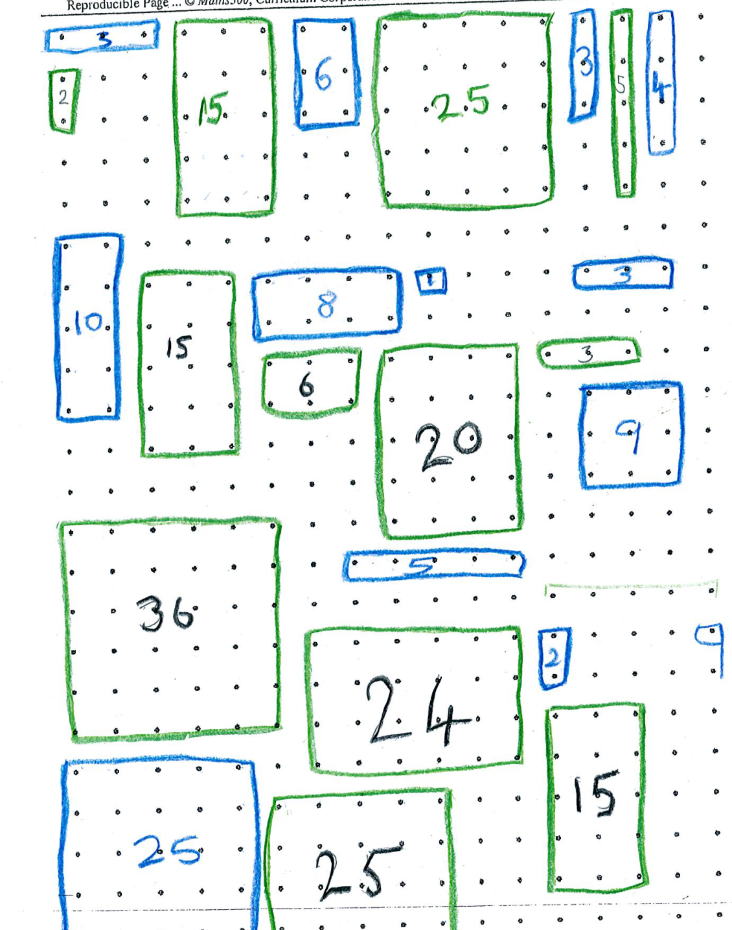

Slide 16
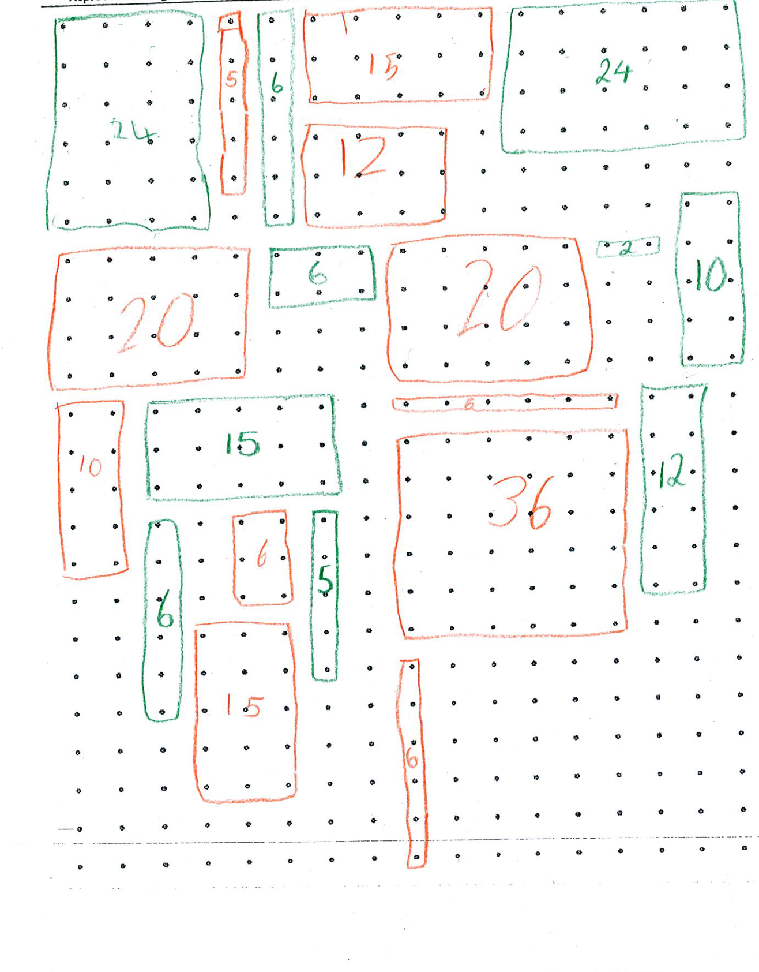

Slide 17
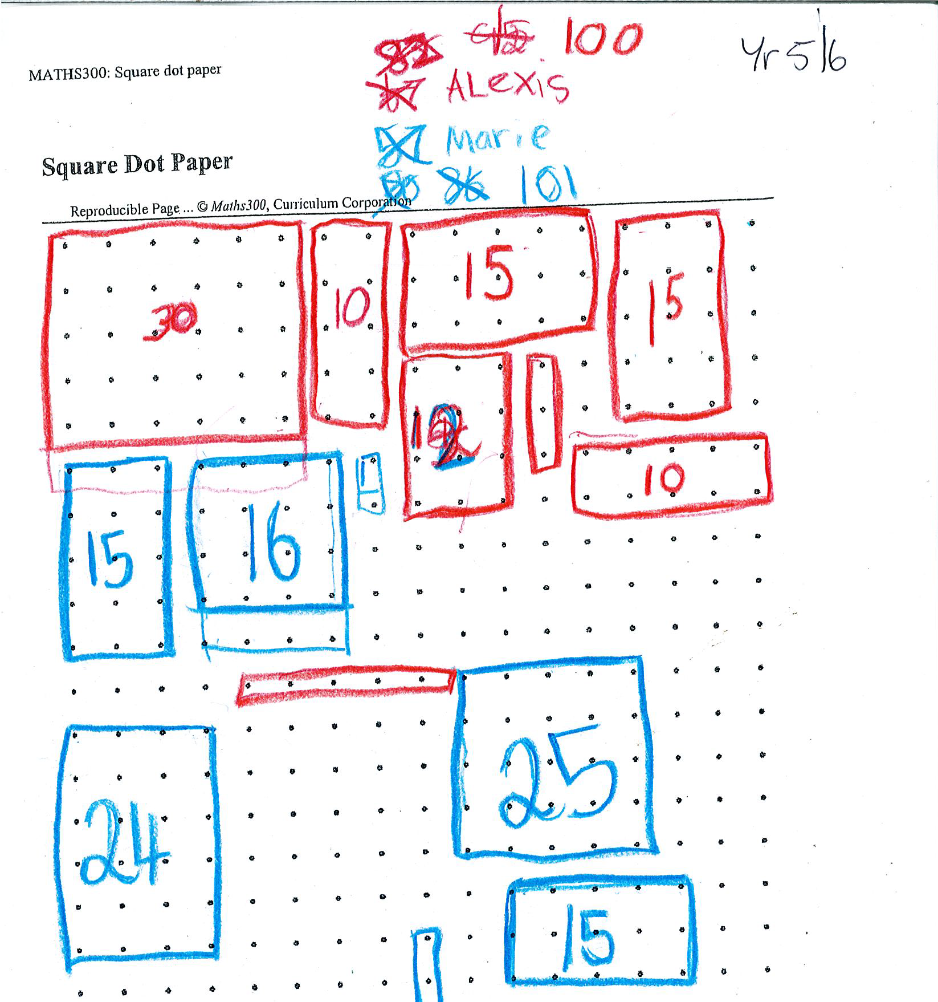

Slide 18
The fractions curriculum

Slide 19
Year 5
Compare and order common unit fractions and locate and represent them on a number line
Investigate strategies to solve problems involving addition and subtraction of fractions with the same denominator
Year 6
Compare fractions with related denominators and locate and represent them on a number line
Solve problems involving addition and subtraction of fractions with the same or related denominators
Find a simple fraction of a quantity where the result is a whole number, with and without digital technologies
Year 7
Compare fractions using equivalence.
Locate and represent fractions and mixed numerals on a number line
Solve problems involving addition and subtraction of fractions, including those with unrelated denominators
Multiply and divide fractions and decimals using efficient written strategies and digital technologies
Recognise and solve problems involving simple ratios

Slide 20
Our lesson
A fraction is a number, and we can use fractions just like we use numbers
Finding ways to work out how to solve problems for ourselves, and thinking about how we can explain our reasoning.

Slide 21
Red rectangle
If the blue rectangle represents
what fraction is represented by the red rectangle?

Slide 22
The pedagogies

Slide 23
Red rectangle
If the blue rectangle represents ,
what fraction is represented by the red rectangle?

Slide 24
Red rectangle
If the blue rectangle represents 4,
what number is represented by the red rectangle?

Slide 25
Red rectangle
If the blue rectangle represents
what fraction is represented by the red rectangle?

Slide 26
The whole square
If the blue rectangle represents 1
what fraction is represented by the red rectangle?

Slide 27
Why high expectations?
Learning will be more robust if students connect ideas together for themselves, and determine their own strategies for solving problems, rather than following instructions they have been given.
Both connecting ideas together and formulating their own strategies is more complex than other approaches and is therefore more challenging.
It is potentially productive if students are willing to take up such challenges.

Slide 28
This connects to “mindsets”
Dweck (2000) categorized students’ approaches in terms of whether they hold either growth mindset or fixed mindset

Slide 29
Students with growth mindset:
Believe they can get smarter by trying hard
Such students
  tend to have a resilient response to failure;
  remain focused on mastering skills and knowledge even when challenged;
  do not see failure as an indictment on themselves; and
  believe that effort leads to success.

Slide 30
Students with fixed mindset:
Believe they are as smart as they will even get
Such students
  seek success but mainly on tasks with which they are familiar;
  avoid or give up quickly on challenging tasks;
  derive their perception of ability from their capacity to attract recognition.

Slide 31
Teachers can change mindsets
This connects to
  the things we affirm (effort, persistence, co-operation, learning from others, flexible thinking)
  the way we affirm
    You did not give up even though you were stuck
    You tried something different
    You tried to find more than one answer
  the types of tasks we pose

Slide 32
Challenging tasks require students to
plan their approach, especially sequencing more than one step;
process multiple pieces of information, with an expectation that they make connections between those pieces, and see concepts in new ways;
choose their own strategies, goals, and level of accessing the task;
spend time on the task and record their thinking;
explain their strategies and justify their thinking to the teacher and other students.

Slide 33
The notion of classroom culture
Rollard (2012) concluded from the meta analysis that classrooms in which teachers actively support the learning of the students promote high achievement and effort. We interpret this to refer to ways that teachers can support students in engaging with the challenge of the task, and in maintaining this challenge as distinct from minimising it.

Slide 34
Some elements of this active support :
the identification of tasks that are appropriately challenging for most students;
the provision of preliminary experiences that are pre-requisite for students to engage with the tasks but which do not detract from the challenge of the task;
the structuring of lessons including differentiating the experience through the use of enabling and extending prompts for those students who cannot proceed with the task or those who complete the task quickly;

Slide 35
the potential of consolidating tasks, which are similar in structure and complexity to the original task, with which all students can engage even if they have not been successful on the original task;
the effective conduct of class reviews which draw on students’ solutions to promote discussions of similarities and differences;
holistic and descriptive forms of assessment that are to some extent self referential for the student and which minimise the competitive aspects; and
finding a balance between individual thinking time and collaborative group work on tasks.

Slide 36
In what ways is this approach culturally responsive?

Slide 37
How does this connect to representation and language?

